Slide 1
The Seven days week and the meanings of their names

Slide 2
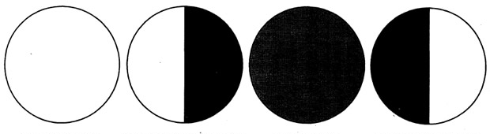
Sumerian calendar
Babylonian calendar
Seven days correspond to the time it takes for a moon to transition between each phase

Slide 3
The Romans named the days of the week after their gods and corresponded to the five known planets plus the sun and moon
Day | Planet | Latin | Spanish | French | Italian
Monday | Moon | Dies Lunae | lunes | lundi | lunedi
Tuesday | Mars | Dies Martis | martes | mardi | martedi
Wednesday | Mercury | Dies Mercurii | miércoles | mercredi | mercoledì
Thursday | Jupiter | Dies Jovis | jueves | jeudi | giovedi
Friday | Venus | Dies Veneris | viernes | vendredi | venerdì
Saturday | Saturn | Dies Saturni | sábado | samedi | sabato
Sunday | Sun | Dies Solis | domingo | dimanche | domenica

Slide 4
The Germanic people adapted the Roman system by identifying Roman gods with their own deities.

Slide 5
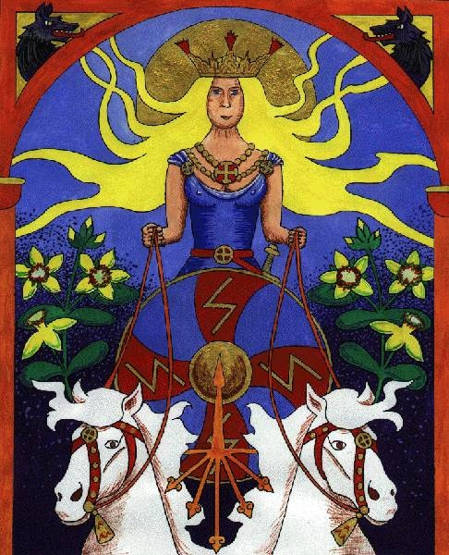
Sunday\ Sunnandæg
Germanic and Norse mythology personify the sun as a goddess named Sunna or Sól.

Slide 6
Monday\Mōnandæg
named after Máni, the Norse personification of the moon

Slide 7
Tuesday\Tīwesdæg
Tiw, or Tyr, a one-handed Norse god of dueling

Slide 8
Wednesday\ Wōdnesdæg
Wōden, or Odin, was the ruler of the Norse gods' realm and associated with wisdom, magic, victory and death

Slide 9
Thursday\ Þūnresdæg
the hammer-wielding Norse god of thunder, strength and protection

Slide 10
Friday\ Frīgedæg
Frigg\ Freya - goddess of love, beauty and fertility

Slide 11
Saturday\ Sæturnesdæg
Saturn is a god of generation, dissolution, plenty, wealth, agriculture, periodic renewal and liberation

Slide 12
Match planets with gods
Moon
Mars
Mercury
Jupiter
Venus
Saturn
Sun
Odin\ Wōden
Freya\Frigg
Sunna or Sól.
Máni
Thor
Tiw\ Tyr
Saturn

